Slide 1









Intro to *NIX (Security Edition)
Jaxon Haws
Notes:
Watch the transitions

Slide 2


About Me
Whoami
3rd Year Computer Science
Clubs:
  CPSEC: President
  CPLUG: President
Security Engineering Intern @ Fortune 50
Favorite Linux Distro: Arch

Slide 3
Table of Contents
Brief history of *NIX
UNIX philosophy & file structure
Security tools for Linux
Recent vulnerabilites

Slide 4
History of Unix
Seems like everyone was writing operating systems back then
1960s Multics
1970 Unics (UNIX)
  Written in assembly for PDP 11
  Written by Ken Thompson, Dennis Ritchie, Brian Kernighan, Douglas McIlroy, and Joe Ossanna at Bell Labs
  Not Open Source
1978 BSD
  Ken Thompson went to Berkeley in 1975

Slide 5

Notes:
Ken Thompson
Dennis Ritchie

Slide 6
Unix Philosophy
Write programs that do one thing and do it well.
Write programs to work together.
Write programs to handle text streams, because that is a universal interface.

Slide 7
Minix
You’ll see this again in CPE 453 with Dr. Nico
Released in 1987 by Andrew S. Tanebaum
Small microkernel architecture
Primarily used for teaching UNIX*
Minix 3 is used in millions of devices daily
Notes:
All Intel chipsets post-2015 are running MINIX 3 internally as the software component of the Intel Management Engine.

Slide 8
History of Linux
Did you mean Freax?
1991 Linus Torvalds begins work on the Linux Kernel & releases version 0.1
1994 version 1.0 is released
1996 version 2.0 is released
2011 version 3.0 is released
2013 Android makes up 75% of global smartphone market share
2015 version 4.0 is released
2019 version 5.0 is released

Slide 9
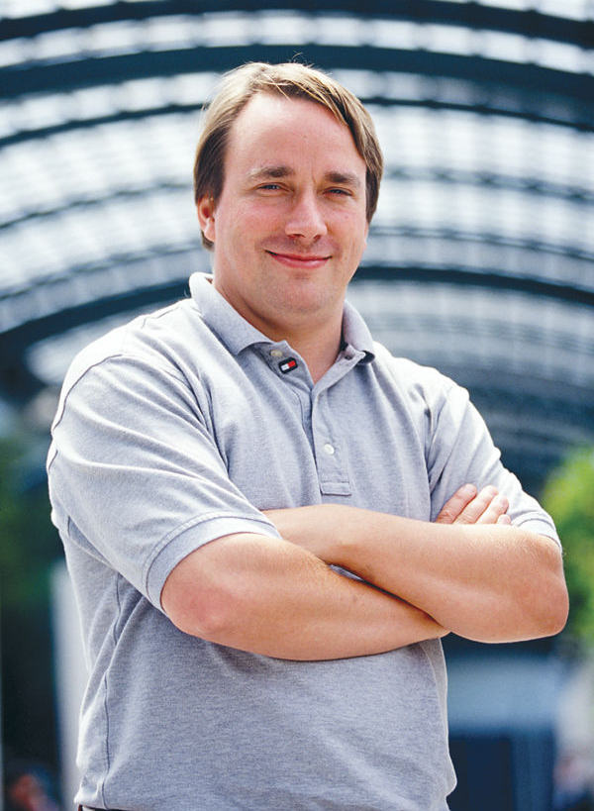
Linus Torvalds
Did you mean Linyos Torovoltos, the Soviet computer hacker?
Hello everybody out there using minix -
I'm doing a (free) operating system (just a hobby, won't be big and professional like gnu) for 386(486) AT clones. This has been brewing since april, and is starting to get ready. I'd like any feedback on things people like/dislike in minix, as my OS resembles it somewhat (same physical layout of the file-system (due to practical reasons) among other things).
I've currently ported bash(1.08) and gcc(1.40), and things seem to work. This implies that I'll get something practical within a few months, and I'd like to know what features most people would want. Any suggestions are welcome, but I won't promise I'll implement them :-)
Linus (torvalds@kruuna.helsinki.fi)
PS. Yes - it's free of any minix code, and it has a multi-threaded fs. It is NOT portable (uses 386 task switching etc), and it probably never will support anything other than AT-harddisks, as that's all I have :-(.
— Linus Torvalds[15]

Slide 10
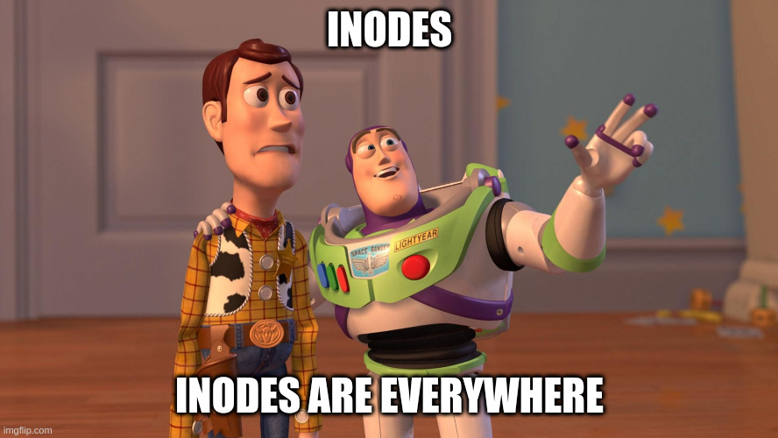
File System Structure
Try echo 15000 > sys/class/backlight/intel_backlight/brightness as root
Everything is a file
Inodes
/
/bin, /boot, /dev, /etc, /home, /lib, /mnt, /opt, /proc, /root, /sbin, /srv, /sys, /run, /tmp, /usr, /var
Notes:
Inodes: “file serial number”
Device ID (this identifies the device containing the file; that is, the scope of uniqueness of the serial number).
File serial numbers.
The file mode which determines the file type and how the file's owner, its group, and others can access the file.
A link count telling how many hard links point to the inode.
The User ID of the file's owner.
The Group ID of the file.
The device ID of the file if it is a device file.
The size of the file in bytes.
Timestamps telling when the inode itself was last modified (ctime, inode change time), the file content last modified (mtime, modification time), and last accessed (atime, access time).
The preferred I/O block size.
The number of blocks allocated to this file.

Slide 11
I’d like to just interject for a moment...

Slide 12
GNU/Linux copypasta
I’d just like to interject for a moment. What you’re refering to as Linux, is in fact, GNU/Linux, or as I’ve recently taken to calling it, GNU plus Linux. Linux is not an operating system unto itself, but rather another free component of a fully functioning GNU system made useful by the GNU corelibs, shell utilities and vital system components comprising a full OS as defined by POSIX.
Many computer users run a modified version of the GNU system every day, without realizing it. Through a peculiar turn of events, the version of GNU which is widely used today is often called Linux, and many of its users are not aware that it is basically the GNU system, developed by the GNU Project.
There really is a Linux, and these people are using it, but it is just a part of the system they use. Linux is the kernel: the program in the system that allocates the machine’s resources to the other programs that you run. The kernel is an essential part of an operating system, but useless by itself; it can only function in the context of a complete operating system. Linux is normally used in combination with the GNU operating system: the whole system is basically GNU with Linux added, or GNU/Linux. All the so-called Linux distributions are really distributions of GNU/Linux!

Slide 13
Distros
Primary forks:
  Slackware
  Debian
  Red Hat
  Jurix/SuSE
  Enoch
  Arch
  Android Open Source Project (AOSP)

Slide 14
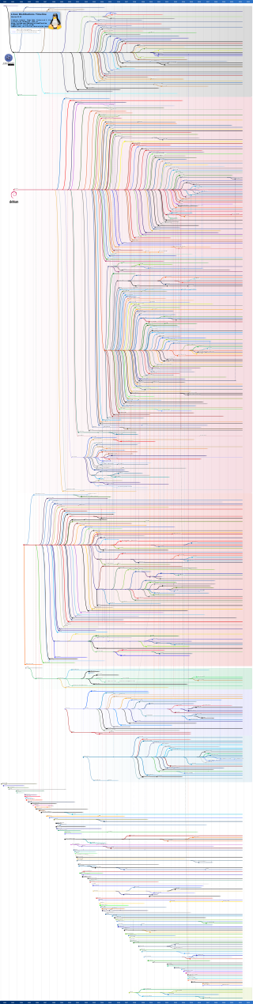

Slide 15
Security tools you should know about

Slide 16
Tools
Firejail, AppArmor, chroot, containers
Firewalld, iptables, nftables
LUKS, dm-crypt
Sudo, visudo, sudoedit
USB Guard
Linux-hardened kernel

Slide 17
Recent Vulns

Slide 18
Sudo
CVE-2021-3156
Heap-based buffer overflow
Affects versions: 1.8.2-1.8.1p2 (legacy) and 1.9.0-1.9.5p1 (stable)
Bug was introduced in July 2011
Found January 2021
sudoedit -s '\' `perl -e 'print "A" x 65536'`

Slide 19
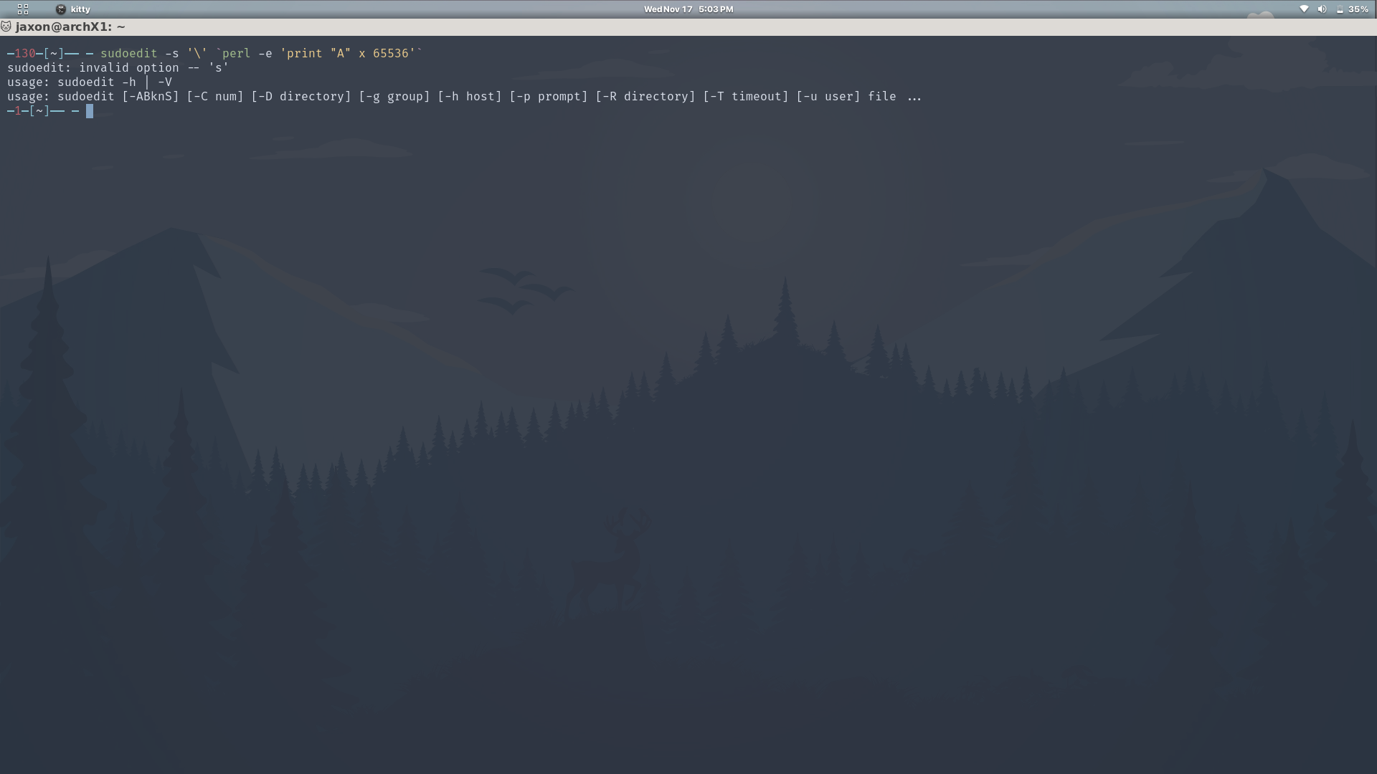

Slide 20
Cinammon 4.2
L33T H4X0R$
December 2020
Kids find lockscreen bypass by mashing keys
https://github.com/linuxmint/cinnamon-screensaver/issues/354

Slide 21
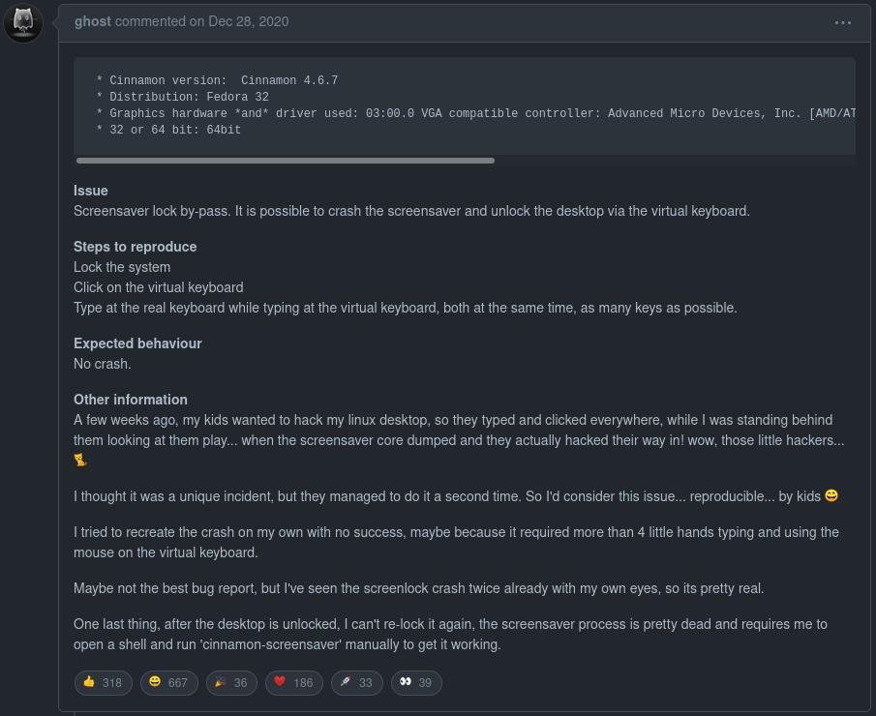

Slide 22

Now a word from our sponsor...

Slide 23
CPLUG – Cal Poly Linux Users Group
Mandatory plug…
Free Your Machine Events
Resource for all things Linux
Linux Workshops next quarter!
Join our discord/email list!
cplug.org

Slide 24
Additional Resources
The Arch Wiki is the source of all knowledge
https://wiki.archlinux.org/title/Security
Advanced Programming in the Unix Environment
The C Programming Language
Operating Systems: Design and Implementation
https://www.gwern.net/docs/cs/2001-12-02-treginaldgibbons-isyoursonacomputerhacker.html
r/linuxmemes

Slide 25
Memes

Slide 26
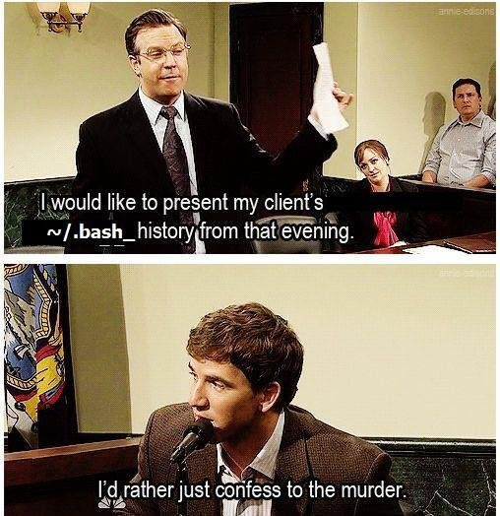

Slide 27
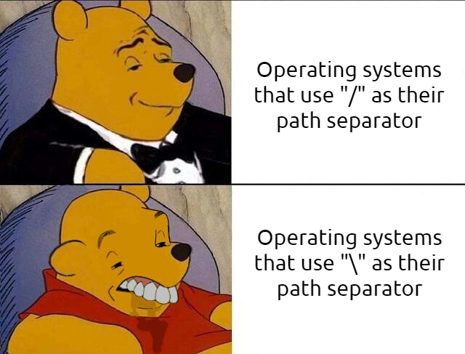

Slide 28
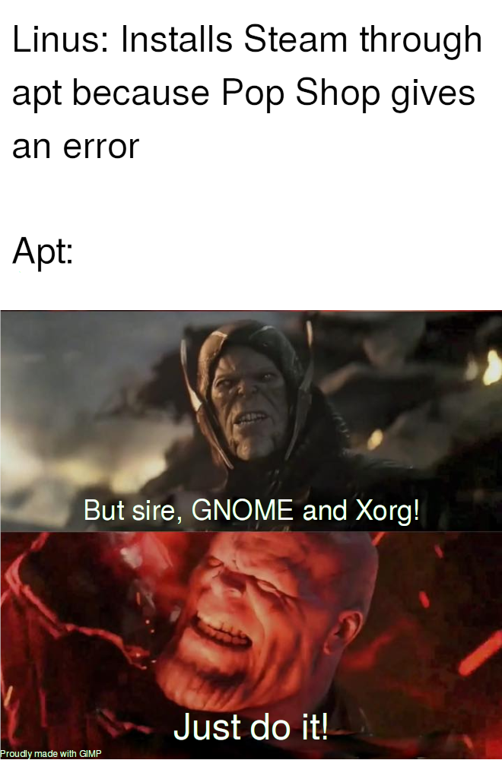

Slide 29


